Slide 1
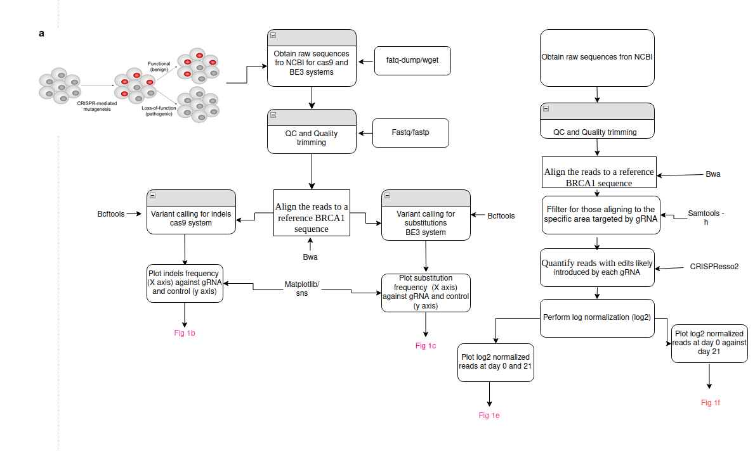
A CRISPR-based base-editing screen for the functional assessment of BRCA1 variants
Group: Charles-Darwin
Team: Bukola, Tiamiyu, RamiAF, George, Leah, Abneer,Joy
TM: Lawrence

